Slide 1
Somers Town Medical & Kings Cross Practice
PPG Meeting
5th March 2026 13:30

Slide 2
How can the PPG support the Practice
Patient Participation Group (PPG)
A group of patients, carers, and practice staff working together to improve healthcare services
What we will be doing:
Shares patient feedback and local insights to help make positive changes at the Practices
Provides honest and constructive suggestions to support the practices
Volunteers and or support with community events like flu clinics, cervical and prostate cancer campaigns
Discussing updates, changes and improvements to practice services and protocols
Getting to know your Practice Team

Slide 3
Meet the Team!

Slide 4
Non-clinical Team
Mohamed S
Admin Team
Omar
Admin Team
Alison D
Regional Manger
Maggie O
Admin Team
Jarrin B
Admin Team
Martha C
Admin Team
Wahida C
Admin Team
Nazmin A
Practice Manager
Kelechi U
Admin Team
Mohammed M
Admin Team
Elizabeth E
Admin Team
Khadija M
Assistant Manager
Zara R
Admin Team
Jahed M
Admin Team
Senior Administrator

Slide 5
GP Workforce
Full name | Role | Sessions per week
Dr Alexandra Hay | Salaried Lead GP | Tues, Wed and Thurs
Dr Sayeeda Rizvi | Salaried GP | Mon
Dr Thomas Das | Salaried GP | Tues and Fri
Dr Rasheed Mosaheb | Salaried GP | Fri
Dr Mohammad Abdullah | GP – Long term locum | TBC
Dr Dinoja Sivarajah. | Salaried GP | Mon , Tues , Wed
Dr Sacha Schillingford-Cammock | Salaried GP | Mon, Tues, weds and Thurs
Dr Daniyal Mehmood | GP-Long term Locum | TBC
Dr Aliya Razaaq | Salaried GP | Mon and Tue
Dr Zia-Uddin Zulfukar | GP - Long term Locum | TBC
Dr Amber Fox | Salaried Lead GP | Mon ,Wed, Thur
Action taken to improve workforce:
Continuing to utilise long-term locums to support continuity of care, with recruitment to substantive GP posts ongoing.
Salaried GP roles have been advertised across multiple platforms (BMJ, Indeed, and NHS Jobs).
We have recruited a new salaried GP, Dr Sivarajah.
Dr Fox has also returned from maternity.

Slide 6
Clinical Workforce
Full name | Role | Hours worked per week
Baiyal Al-Mesaouil | Practice Nurse | FULL TIME Mon- Thurs
Jurate Baziene | HCA | FULL TIME Mon- Fri
Sharif Anwar | Clinical Pharmacist | FULL TIME Monday-Thurs
Claire Ofoegbu | Clinical Pharmacist | FULL TIME- Tues and Weds based in Somers Town Thurs and Fri based in KX
Luthfa Miah | Clinical Pharmacist | FULL TIME Mon- Fri
Jessica Jacob | Practice Nurse | FULL TIME Tues- Fri
Ghazala Yasmeen Robyn Baxter Abbey | HCA Nursing Associate Physicians Associate | FULL TIME- Mon- Fri TBC FULL TIME Mon and weds

Slide 7
⭐ What Do We Want Our Patients to Say About Us?
“I feel heard, respected, and involved in every decision about my care.”
“The practice works closely with other services to make sure all my health needs are met.”
“I’d confidently recommend this practice to my family, friends, and anyone new to the area.”
“This practice is a valued part of the community and truly cares about promoting health and wellbeing.”
“The care here is always safe, effective, and easy to access when I need it.”

Slide 8
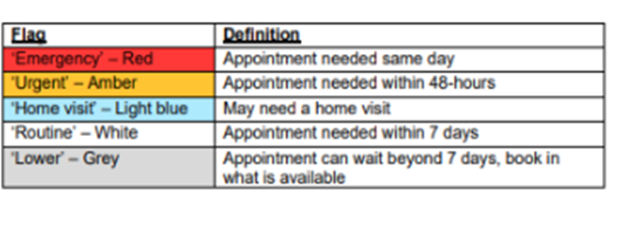
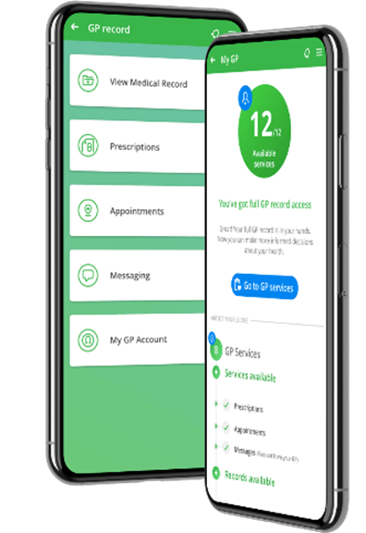

Evergreen Powered by DriQ is now open 8:00 – 6:30 pm.
Urgent queries will open from 7:45 every morning and closes once we reach full capacity. If you call for an urgent appointment once the practice has reached capacity the admin team will re direct you to Call 111 or attend A&E.
Routine queries will remain opened and will be triaged between 3- 5 working days. Once triaged you will then be contacted for an appointment.
We are encouraging patients who can use the Evergreen app to put in request themselves as the triaging Doctor has more efficient information to triage appropriately.
If you are unable to use the evergreen app, please ask the receptionist for assistance.
When calling the reception, the staff will ask you a few questions about the request. Please give as much relevant details as possible.

Slide 9
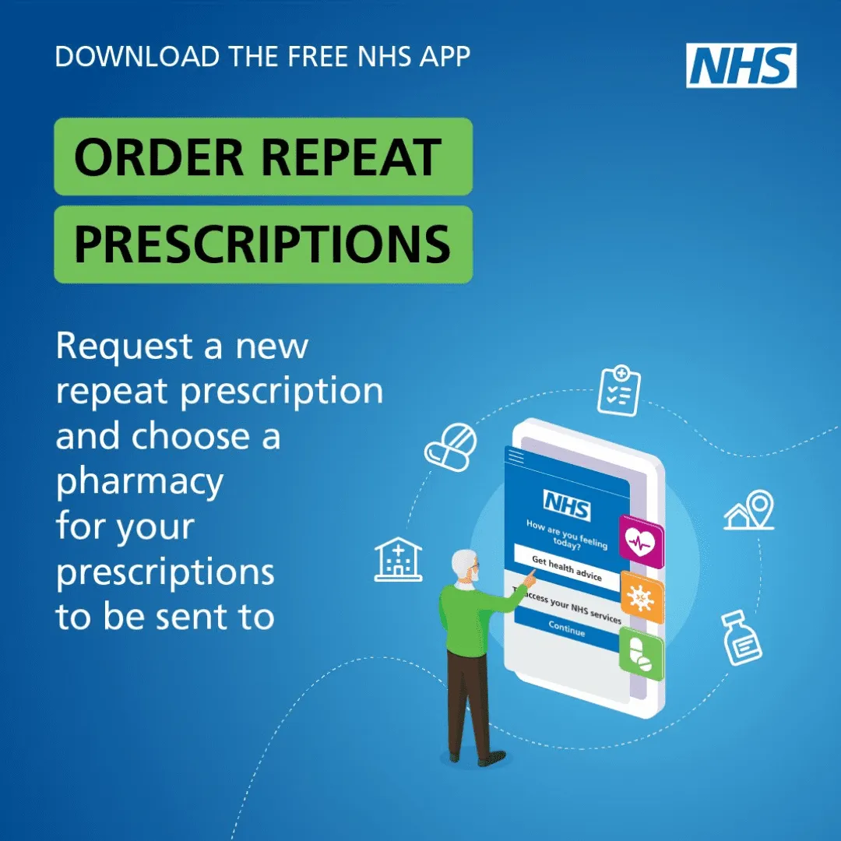
Repeat Prescriptions
Somers Town Medical Centre and King’s Cross Surgery follow a three working- day prescriptions policy.
You are able to request prescriptions online either via the evergreen app or NHS app
Pharmacies are also able to request prescriptions on behalf of patient, please speak to your pharmacy regarding this.
If you need an emergency supply of repeat medication
Please Contact 111

Slide 10
Patient Experience
Friends and Family Test (FFT) –
The Friends and Family Test (FFT) is a simple feedback tool used across the NHS to gather patient opinions on the care and services they receive. Patients are asked whether they would recommend the practice to their friends and family if they needed similar care.
How it helps the practice and patients:
Improves Patient Experience: Feedback highlights what patients value most and where improvements are needed.
Supports Service Development: Allows the practice to identify patterns and make informed decisions to enhance services.
Encourages Patient Involvement: Gives patients a voice in shaping the care they receive.
Promotes Accountability: Helps maintain high standards by regularly reviewing and reflecting on patient feedback.

Slide 11
Plans, Changes and upcoming Events :
March 2026- June 2026
March 2026
April 2026
Carers Event to take place on 2nd April at the Practice
Reception team expanding to provide better quality care.
Wellbeing Wednesdays is still active every Wednesday at the living Centre
May 2026
Continuous recruitment for more salaried GP’s
Introducing Evergreen Pop up sessions every week
Advisory appointment service will launch for patients from April.
Merging of both Somers Town Medical Centre and Kings Cross surgery.

