Slide 1
Somers Town Medical & Kings Cross Practice
PPG Meeting
14th July 2026 13:00

Slide 2
How can the PPG support the Practice
Patient Participation Group (PPG)
A group of patients, carers, and practice staff working together to improve healthcare services
What we will be doing:
Shares patient feedback and local insights to help make positive changes at the Practices
Provides honest and constructive suggestions to support the practices
Volunteers and or support with community events like flu clinics, cervical and prostate cancer campaigns
Discussing updates, changes and improvements to practice services and protocols
Getting to know your Practice Team

Slide 3
Meet the Team!

Slide 4
Non-clinical Team
Mohamed M
Admin Team
Martha C
Admin Team
Alison D
Regional Manger
Maggie O
Admin Team
Muhaimin A
Admin Team
Ormar A
Admin Team
Wahida C
Admin Team
Nazmin A
Practice Manager
Kelechi U
Admin Team
Mohamed S
Admin Team
Elizabeth E
Admin Team
Khadija M
Assistant Manager
Zara R
Admin Team
Hafeja I
Admin Team

Slide 5
GP Workforce
Full name | Role | Sessions per week
Dr Alexandra Hay | Salaried Lead GP | Tues, Wed and Thu
Dr Sayeeda Rizvi | Salaried GP | Mon
Dr Thomas Das | Salaried GP | Tues and Fri
Dr Rasheed Mosaheb | Salaried GP | Fri
Dr Mohammad Abdullah | GP – Long term locum | TBC
Dr Dinoja Sivarajah | Salaried GP | Mon , Tues , Wed
Dr Sacha Shillingford-Cammock | Salaried GP | Mon, Tues, Wed and Thu
Dr Danyal Mehmood | GP-Long term Locum | TBC
Dr Aliya Razaaq | Salaried GP | Mon and Tue
Dr Zia-Uddin Zulfukar | GP - Long term Locum | TBC
Dr Amber Fox | Salaried Lead GP | Mon ,Wed, Thu
Action taken to improve workforce:
Continuing to utilise long-term locums to support continuity of care, with recruitment to substantive GP posts ongoing.
Salaried GP roles have been advertised across multiple platforms (BMJ, Indeed, and NHS Jobs).
We have recruited a new salaried GP, Dr Sivarajah.
Dr Fox has also returned from maternity.

Slide 6
Clinical Workforce
Full name | Role | Hours worked per week
Baiyan Al-Mesaouil | Practice Nurse | FULL TIME Mon- Thu
Jurate Baziene | HCA | FULL TIME Mon- Fri
Sharif Anwar | Clinical Pharmacist | FULL TIME Monday-Thurs
Claire Ofoegbu | Clinical Pharmacist | FULL TIME- Tues and Wed based at Somers Town Thu and Fri based in KX
Luthfa Miah | Clinical Pharmacist | FULL TIME Mon- Fri
Jessica Jacob | Practice Nurse | FULL TIME Tues- Fri
Ghazala Yasmeen Robyn Baxter Abshana Nishanthan | HCA Nursing Associate Physicians Associate | FULL TIME- Mon- Fri FULL TIME- Mon- Fri Mat leave

Slide 7
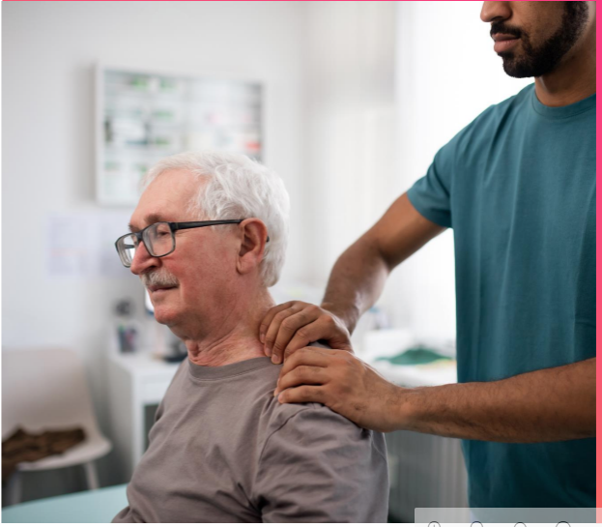
Carers Event
We will be hosting a Carers event at the Practice date TBC
We would like all Carers to be identified as a carer as you are eligible to :
Free Influenza Vaccinations
Carers Reviews with a GP
A range of support services within the community and NHS.

Slide 8
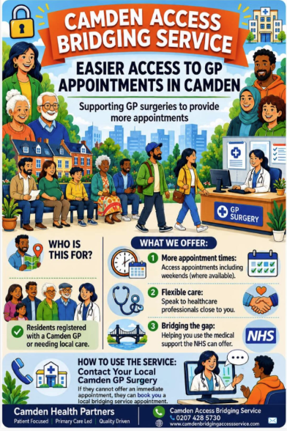
Services Available to you !
Camden GP HUB
The Hub service has now formally changed to a new service since 1st July 2026. It is now the Camden Bridging Access Service ( CBAS)
It is open Monday – Friday between 12:00 and 20:00
On Saturday , Sunday and Bank Holidays the service is open from 08:00 – 20:00 .
The service will no longer be running from Somers Town Medical centre.
The new sites are now :
Brondesbury Medical Centre & Regents Park Practice

Slide 9
Physio Appointments and Blood Tests:
Physio Appointments
We Have First Contact Physio Appointments Available at Kings Cross Surgery on Monday , Wednesday and Thursday.
These appointments are available to All Camden GP Patients, so appointments are very limited.
Camden MSK also offer a self referral service for patients. The Admin team will also be sending patients self referral links.
Blood Test Appointments
At the Practice we have very limited blood test appointments which can only be reserved for vulnerable patients.
The Admin team will be encouraging patients to go to the other sites available such as :
Hunter Street , WC1 1BN
James Wigg Practice , NW5 2BX
Finsbury Health Centre , N1 2DE
River Place Health Centre , EC1R 0JH

Slide 10
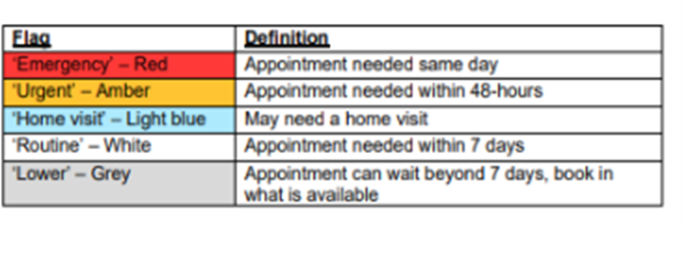
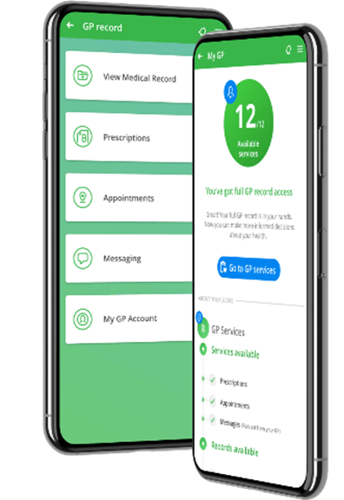

Evergreen Powered by DriQ is now open 8:00 – 6:30 pm.
Urgent queries will open from 7:45 every morning and closes once we reach full capacity. If you call for an urgent appointment once the practice has reached capacity the admin team will re direct you to Call 111 or attend A&E.
Routine queries will remain opened and will be triaged between 3- 5 working days. Once triaged you will then be contacted for an appointment.
We are encouraging patients who can use the Evergreen app to put in request themselves as the triaging Doctor has more efficient information to triage appropriately.
If you are unable to use the evergreen app, please ask the receptionist for assistance.
When calling the reception, the staff will ask you a few questions about the request. Please give as much relevant details as possible.

Slide 11
⭐ What Do We Want Our Patients to Say About Us?
“I feel heard, respected, and involved in every decision about my care.”
“The practice works closely with other services to make sure all my health needs are met.”
“I’d confidently recommend this practice to my family, friends, and anyone new to the area.”
“This practice is a valued part of the community and truly cares about promoting health and wellbeing.”
“The care here is always safe, effective, and easy to access when I need it.”

Slide 12
Patient Experience
Friends and Family Test (FFT) –
The Friends and Family Test (FFT) is a simple feedback tool used across the NHS to gather patient opinions on the care and services they receive. Patients are asked whether they would recommend the practice to their friends and family if they needed similar care.
How it helps the practice and patients:
Improves Patient Experience: Feedback highlights what patients value most and where improvements are needed.
Supports Service Development: Allows the practice to identify patterns and make informed decisions to enhance services.
Encourages Patient Involvement: Gives patients a voice in shaping the care they receive.
Promotes Accountability: Helps maintain high standards by regularly reviewing and reflecting on patient feedback.

Slide 13
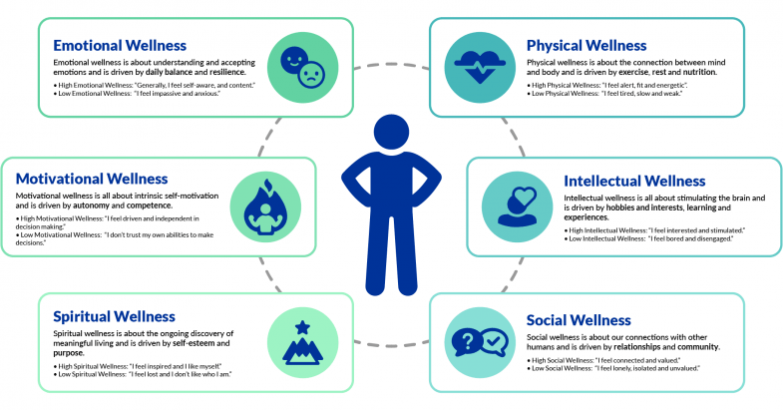
Health Campaigns:
The recall team will be contacting patients that are eligible for the following reviews:
Dementia
Diabetes
Heart Failure
Mental Health
NHS Health Check
Immunisations
Smear Test
Bowel Screening
Asthma/ COPD
It is important that if you are invited for these reviews that you attend so we can monitor your health.
Awareness events will also be hosted at the practice to give patients a chance to get more information of the reviews.

Slide 14
Website & Notice Boards
Our websites are all up to date now.
For Somers Town Medical Centre please visit. somerstownmedical.co.uk
For Kings Cross Surgery please visit kingscrosssurgery.co.uk
Via our website you can:
Access the Evergreen Life app
Order repeat prescriptions
Complete online registrations
Information is also available around our reception area notice boards.

